Slide 1
Group 1 – Churn Fortuneteller
MTech 2020 – Semester 1 - IRS

Slide 2
Team Introduction
Anirban Kar Chaudhuri (Main Presenter)
Maradana Vijaya Krishna
Putrevu Manoj Niyogi
Sivasankaran Balakrishnan

Slide 3
Project Overview
Project Title: Customer Churn Analysis
Sector: Telecommunication Sector
Objective: Build machine learning model to predict the customer churn.
Data Source: Telecom customer churn dataset of 7000+ records.

Slide 4
Project Objective
Customer churn is one of the main factors that will affect the Telecom industry player’s market share & the revenue.
Aim to identify those customers about to churn in a near future and take necessary action to reduce customer churn rate.
Build machine learning modules that will predict those customers about to churn
Validate the machine learning models and optimize their performance.

Slide 5
Technologies Used
Python Libraries
Pandas
Numpy
Matplotlib
Seaborn
Sklearn
XGBClassifier
Plotly
Flask interface for model user-end interaction

Slide 6
Visualisations
Heatmap
Boxplot analysis
Pie Charts
Countplots

Slide 7
Predictors
Numeric Influencers – monthly charge, tenure, total charge
Categorical Influencers:
Demographics - senior citizen, dependents, partner
Security – Online Security, Online Backup, Device Protection,
Tech Support,
Premium Services – Stream TV & Stream movies
Payment & Billing: Payment Method, Paperless Billing, Contract

Slide 8
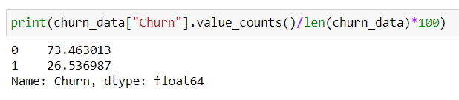
Churn Category Distribution
Churn instances in the entire dataset are under-represented in original dataset. Machine learning models have hyperparameters where you can assign higher weight to minority class.
Reason: model biased towards non-churn instances

Slide 9
Architecture
Rule Based Reasoning
XGBoost & Random Forest Model
Random Search Optimisation to improve model performance
Churn: Yes/No
Customer Profiler using cluster analysis
Churn Risk Category

Slide 10
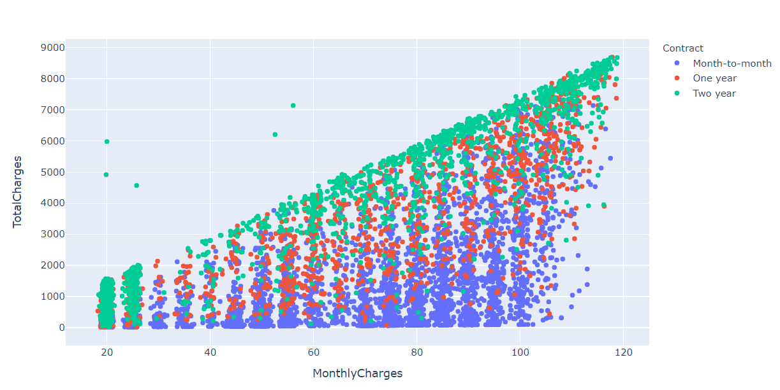
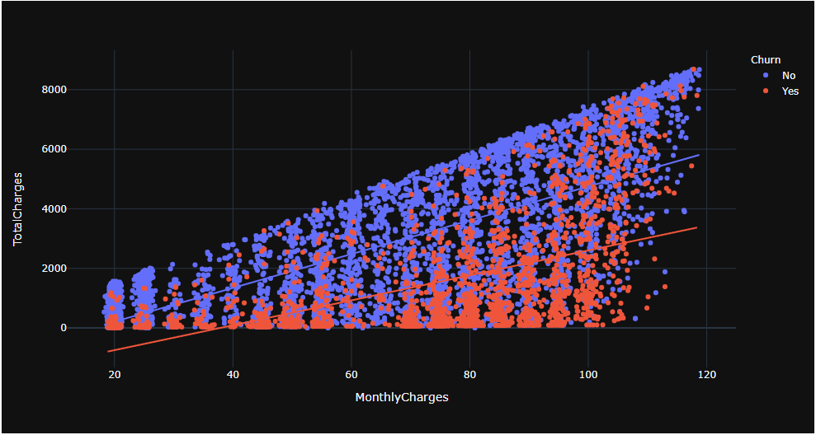
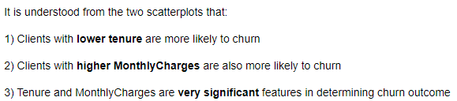
Scatterplot Analysis – Monthly Charges & Total Charges

Slide 11
Supervised Machine Learning Models Tried
Random Forest Classifier (bagging) – Sum of individual decision trees and averaging over independent subsets of data (sampled with replacement)
XGBoost Classifier (boosting) - Each decision tree learns from errors from previous learners which are assigned higher weights, sequential learners, optimization over error function
Chosen Model: XGBoost (Better metric)

Slide 12
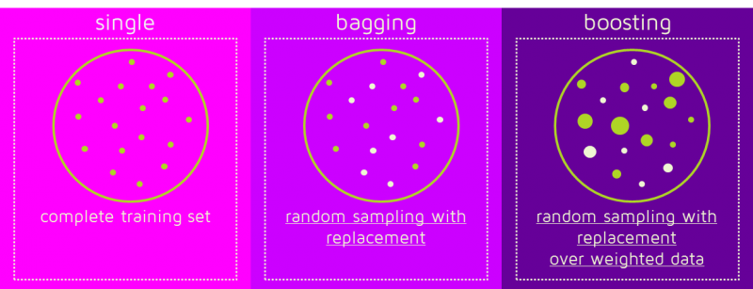
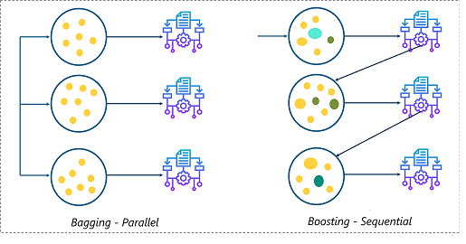
Ensemble Modelling Principles

Slide 13
Supervised Machine Learning Models Tried
Random Search Optimization
Begin by selecting certain hyperparameter search space
Randomness or probability (typically in the form of a pseudorandom number generator) in its methodology.
The random element may be introduced through sampling specifications of the algorithm, or through noise in the function observation

Slide 14
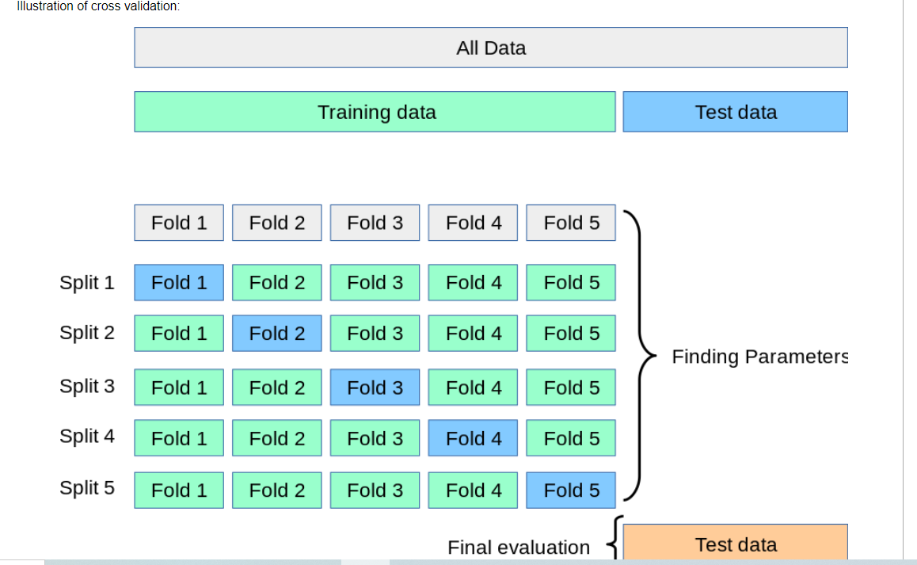
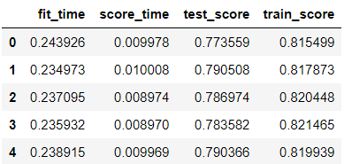
Training Models
First, split data into train and test

Slide 15
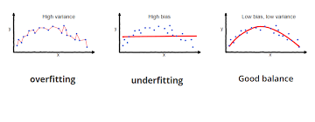
Bias Variance Trade-off

Slide 16
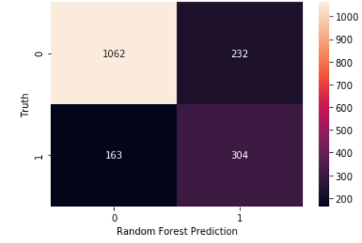
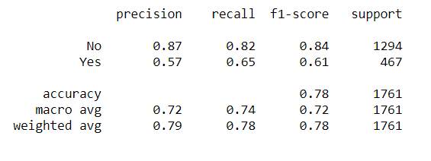
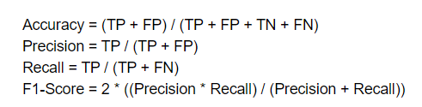
Metric
Classification Report
Confusion Matrix

Slide 17
Rules Inferred So Far From Visualisations
Level 1 Rules:
If Dependents= “Yes” or Partner = “Yes”, then Family_Person = 1
If Contract = “One year” or Contract = “Two year”, then Committed = 1
If TechSupport = “Yes” or OnlineSecurity = “Yes” or OnlineBackup = “Yes” or DeviceProtection = “Yes” then Protection = 1
If InternetService = “Fiber Optic” or InternetService = “DSL” then Has_Internet = 1
If StreamingTV = “Yes” or StreamingMovies = “Yes” then Streaming =1
If PaymentMethod not “MailedCheck” then Tech_Payment = 1
Level 2 Rules:
If Tech_Payment = 1 and Streaming = 1, then Techie is 1.
If Multiple_Lines = “Yes” and Internet_Service = “Fiber Optic” then Premium_Services = 1
This is forward inference chaining.

Slide 18
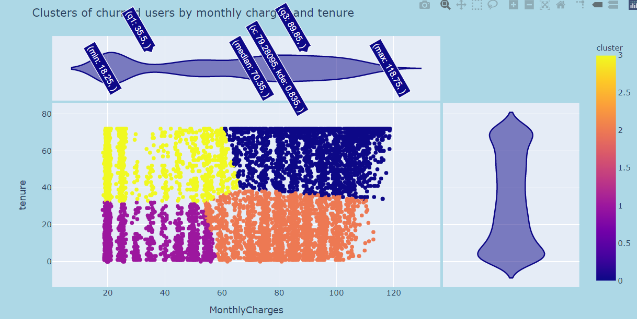
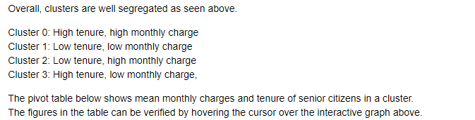
Cluster Analysis – Based on Monthly charges and Tenure

Slide 19
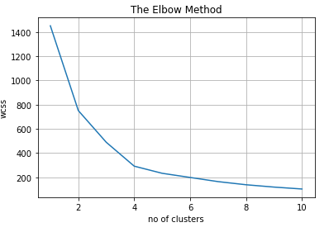
Cluster Analysis – Based on Monthly charges and Tenure

Slide 20
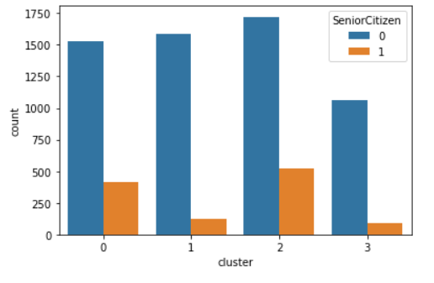
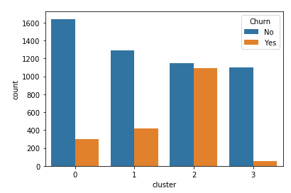
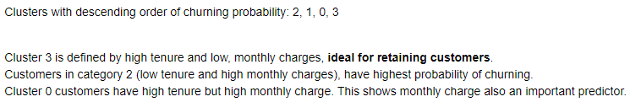
Cluster Analysis – Based on Monthly charges and Tenure
Senior citizens fall under clusters 0 and 2, clusters with high monthly charge. The number of senior citizens in low tenure clusters outnumber those in high tenure clusters.

Slide 21
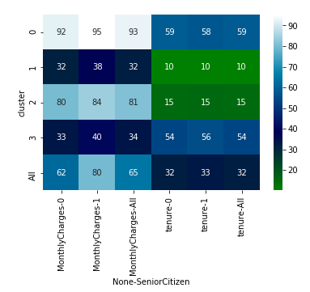
Cluster Analysis – Monthly charges and Tenure of Senior Citizens
Marginal figures are given too.
Joint effect of two random variable can be deduced as well.

Slide 22
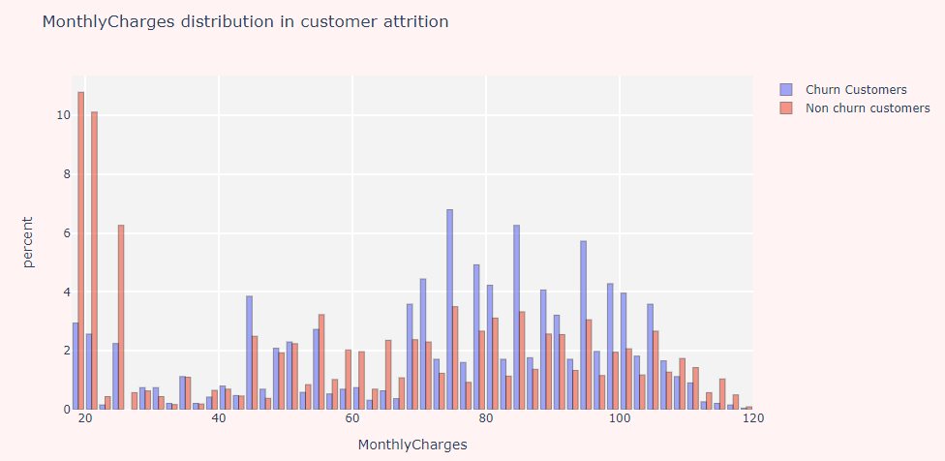
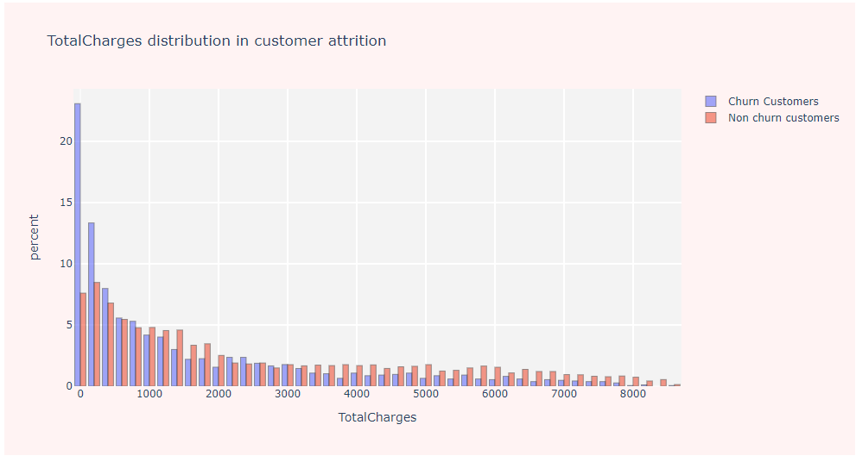

Customer Churn Analysis – Based on Numeric Influencers

Slide 23
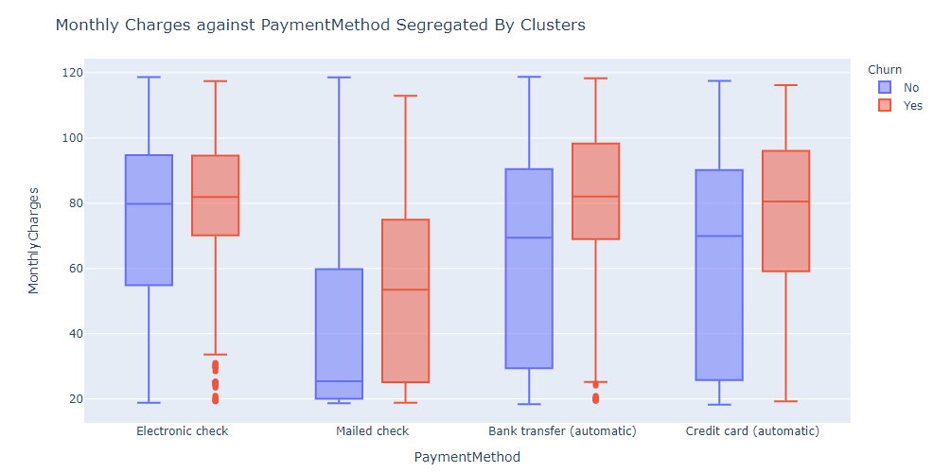
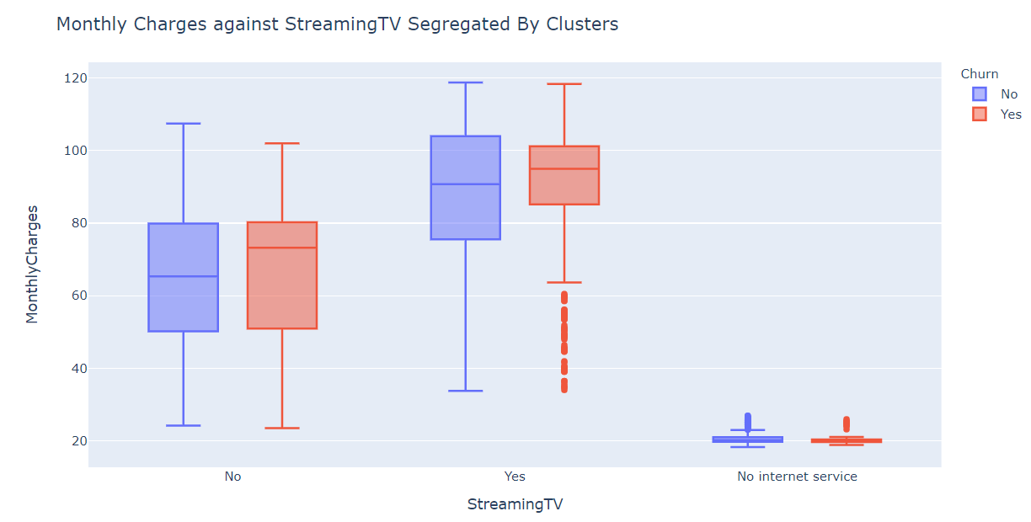
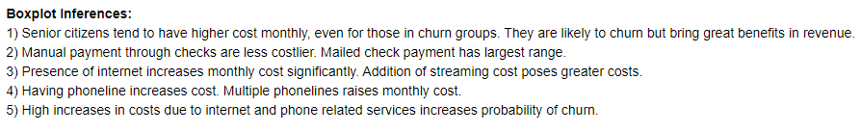
Cluster Analysis – Based on Monthly charges

Slide 24
Business Threshold
Average industry thresholds for churn:
Recall - 80%
Precision – 70%
Current deficiencies – lack of data representing churn categories

Slide 25
Business Evaluation
Identifying the customer segments and their behaviors that lead to churn you can design recommendations for your team to increase customer retention. Designing, implementing, and inferring results from smart experimentation is a topic of another article but here are some quick ideas.
For a telecom company experiencing churn with low income demographics who are using more texts than actual telephone calls, it may be about creating a niche ‘plan’ targeted to that segment to prevent the users from switching to the next provider.

Slide 26
Possible Solutions For Churn Reduction
Value-added services serve as a subscriber retention tool, especially for established players. While for newer entrants, it will become a part of the marketing strategy to attract customers. If VAS providers leverage the opportunities to tie up with operators, there could be a major increase in the uptake of their services.
Offer upgrades on the client’s existing account. Expanding on services offered and giving better rates or discounts to the client often improves customer retention rates.
Competing cellular providers aggressively market special deals to churn customers away from their current provider. Common practices include offering free phones and buying out any existing service contract. The cellular service business is highly competitive and will likely remain so; therefore, churn rates will continue to be an important focus for cellular providers.
One-on-one marketing campaigns is one of the best tactics to reduce churn rate. Make sure that customers are communicated the new services offering based on their usage analysis and trends and should be given proactive information on the plans which will benefit the customer.

Slide 27
Deployment
Flask to deploy model application on webserver

Slide 28
QA Session
THANK YOU!

